Slide 1
Report
for May 2020 MP
BFX - AT100 (T99X171.00)
Date : 20 June 2020
Prepared by: Luu Mien

Slide 2
Issue Description
5 June 2020, ALT customer complain [BFX-AT100] May 2020 Mass production issue.
Defect Total:
1. No power on (Critical) : 1/500pcs (0.2%)
2. No HDMI Output (Critical) 1/500pcs (0.2%)
3. LED lens cosmetic defect (Minor) : 1/500pcs (0.2%)
4. Gift-box damaged (Minor) : 1/500pcs (0.2%)
5. HDMI cable no output to TV (Minor) : 2/500pcs (0.4%)
6. Ethernet cable NG (Minor) : 1/500pcs (0.2%)

Slide 3
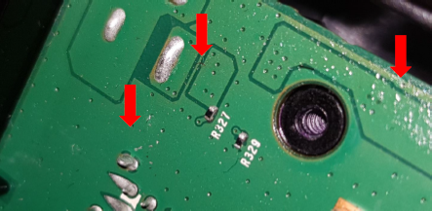
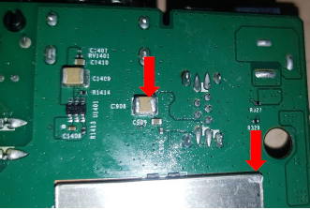
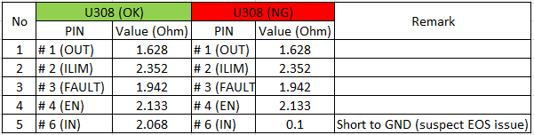
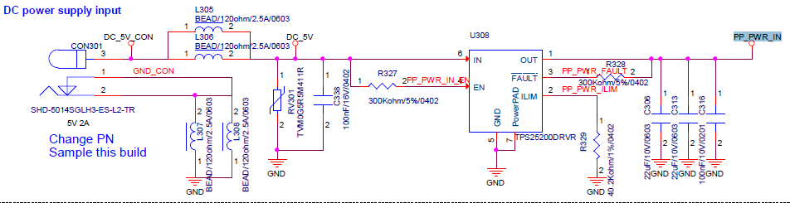
1. No power on
Issue Description | Root Cause | Actions | Owner | Due Date | Status
Phenomenon: No power on Type: Critical Q’ty : 1/500pcs DR: 0.2% | VI and found out solder splashes on PCBA (pictures below) ➔ May be in touching up process at PTH, operator did not operate carefully lead to this phenomenon. PTH VI also did not check carefully lead to escaped the defect. 2. X-Ray inspection: no issue found. 3. Checked the power: P5V, P3V3, P1V8, P1V8_EMMC, P1V2, P2V5, VDDCPU and VDDEE --> found out PP_PWR_IN no output. Checked console information --> no issue found. Suspect U308 (IC SW 2.5~6.5V SMD WSON6 GP TPS25200) component issue. | Showed a quality alert for solder splashes on PCBA issue and re-trained PTH operator need check carefully to avoid defect escape. Used a multi-meter to check internal impedance of U308 component found out the U308_PIN6 (IN) short to GND, result as below: Changed new U308 component then pass. Suspect EOS issue make U308 damaged | PQE-Mien PE-Frank | 10 Jun 20 20 Jun 20

Slide 4
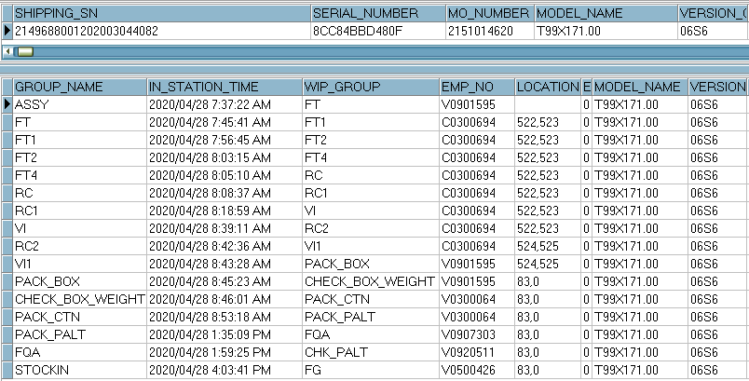
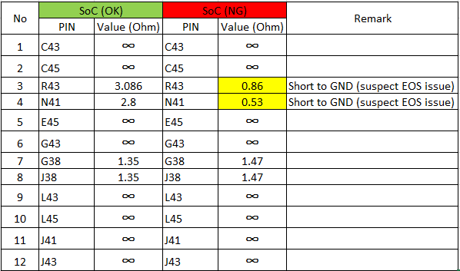

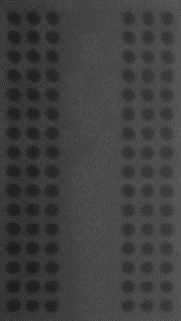
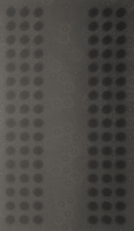
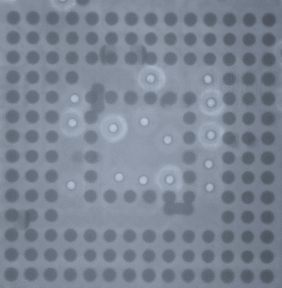

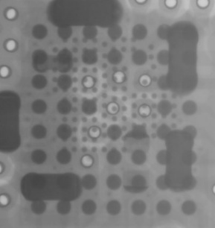
2. No HDMI output
Issue Description | Root Cause | Actions | Owner | Due Date | Status
Phenomenon: No HDMI output. Type: Critical Q’ty : 1/500pcs DR: 0.2% | Checked history. This unit was passed all stations smoothly. Visual inspection and X-Ray inspection no issue found. OTT boot up normal but not HDMI signal out. Checked the power: P5V, P3V3, P1V8, P1V8_EMMC, P1V2, P2V5,VDDCPU and VDDEE are system clock no issue found. 5. Checked console information --> no issue found Suspect Soc component issue. | Used a multi-meter to check impedance of Soc component for all HDMI PIN -> found out U1_PIN R43 (HDMI_SDA) and U1_PIN N41 (HDMI_SCL) short to GND, result as below: Changed new Soc component and eMMC then pass. Suspect EOS issue make SOC damaged | PE-Frank | 20 Jun 20
Soc
DDR
EMMC
FIL1401 FIL1402
U1001

Slide 5

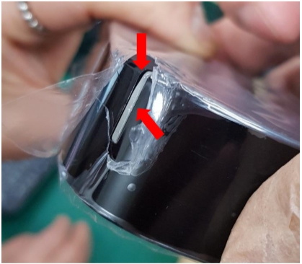
3. Led Lens cosmetic defect
Issue Description | Root Cause | Actions | Owner | Due Date | Status
Phenomenon: Led lens cosmetic defect Type: Minor Q’ty : 1/500pcs DR: 0.2% | Root cause: This issue is from incoming material issue. Escaped cause: Top case was covered by a protective film. Operator at Assembly station did not check carefully before assembling housing. Operator at VI station also did not check visual carefully lead to escaped. | SQE was responsible for inform and send the defect to vendor for further analysis and give out report of root cause and corrective action. Please refer to below attached file for vendor’s report. Showed and re-trained operator at assembly and VI station need to check more carefully to avoid this defect escape. Line leader often check and remind all operators at all stations need check carefully. IPQC keep sample check and audit daily in production line. | SQE-Mai PQE-Mien PD-Loi PQE-Mien | 23 Jun 20 10 Jun 20 10 Jun 20 10 Jun 20

Slide 6
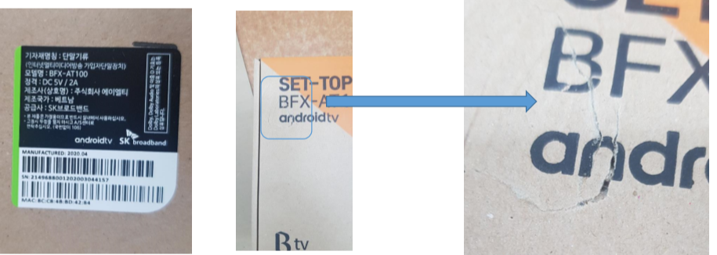
4. Gift-box damaged
Issue Description | Root Cause | Actions | Owner | Due Date | Status
Phenomenon: Gift-box damaged Type: Minor Q’ty : 1/500pcs DR: 0.2% | Operator at Packing carton station did not operate carefully during taking box from production line to carton lead to touch with strong force to nearly printer caused this defect. He put this box to carton directly and not check again lead to escape. | Showed quality alert and re-trained operator this defect to operate more carefully. Line leader often check and remind all operators at all stations need operate carefully. IPQC keep sample check and audit daily in production line. | PQE-Mien PD-Loi PQE-Mien | 10 Jun 20 10 Jun 20 10 Jun 20

Slide 7
5. HDMI cable no output to TV
Issue Description | Root Cause | Actions | Owner | Due Date | Status
Phenomenon: HDMI cable no output to TV. Type: Minor Q’ty : 2/500pcs DR: 0.4% | This issue was from incoming material issue. | FXC rechecked and confirmed the defect. SQE is responsible for inform and send the defect to vendor (18.June.2020) for further analysis and give out report of root cause and corrective action. (due date: 3 days after vendor receiving defects) | SQE-Mai PE-Frank SQE-Mai | 20 Jun 20 3 Jul 20

Slide 8
6. Ethernet cable NG
Issue Description | Root Cause | Actions | Owner | Due Date | Status
Phenomenon: Ethernet cable NG. Type: Minor Q’ty : 1/500pcs DR: 0.2% | This issue was from incoming material issue. | FXC rechecked and confirmed the defect. SQE is responsible for inform and send the defect to vendor (18.June.2020) for further analysis and give out report of root cause and corrective action. (due date: 3 days after vendor receiving defects) | SQE-Mai PE-Frank SQE-Mai | 20 Jun 20 3 Jul 20

